Slide 12
Value Added Services
In Services: Nuell, Inc offers CE Accredited Educational In services through IAHCSMM on proper care and handling of your powered equipment. Our in services cover proper cleaning and sterilization techniques, along with several tips that we have found beneficial to maintaining your powered equipment and accessories.
Inspections: Nuell, inc. offers onsite courtesy inspections of your powered surgical equipment. A trained Nuell staff member will come to your facility and go through all of your powered surgical instruments and accessories. During the inspection process we will diagnose your powered equipment, both sterile and non sterile. Through testing we check for heat, air leakage, proper function of the equipment acceptance of all attachments and accessories. Visual inspections of o-rings for tears and knicks caused by normal wear and tear from the air hoses, corrosion and rust, free movement of any and all manual components such as Jacobs chucks, acceptance of pins, wires, burs and blades, and assurance that loctite is in place where necessary, so vibration from the hand piece does not allow components to come loose and become a patient safety issue. An inventory list with serial numbers is generated of your powered equipment with a determination of what needs repaired immediately, what needs repaired in the next 90 -120 days, and what is in working condition. The purpose of the inspection process is to catch the minor repairs before they become major repairs.
Preventative Maintenance Program: Nuell, Inc. offers Preventative Maintenance Programs. These programs allow hospitals to place all of their powered surgical equipment on a program for one year with a fixed repair cost for the entire year. This program carries a warranty on repairs and allows you to send your powered surgical equipment in either two (2) or four (4) times during the year, after signing an agreement.

Slide 13
Care & Handling of Power Equipment
Water
To help avoid water damage in your equipment
Do Not submerge attachments and or hand pieces in standing water Powered equipment should be hand washed at a 90 degree angle Shake water and excess moisture off of hand pieces
Keep air hose attached to hand piece during cleaning Dry hand pieces and attachments with a lint free towel
Use an air hose to externally blow excess water off of hand pieces and attachments Properly wrap hand pieces and attachments to draw excess moisture away from powered
equipment during the sterilization process.
Batteries and the Autoclave
Remove battery from hand piece, inspect for cracks or damage
Once cleaned make sure the battery is completely dry before charging Charge the battery fully before wrapping
Either wrap or peel pouch batteries (only tyvek pouches can be used in a Sterrad System) Label wrap with proper indicator tape or pouch to indicate expiration date of batteries charge which is normally 48 hours from initial charge.
Rotate and recharge unused batteries as necessary
Lubrication
Most hand pieces do not require lubrication as the motors are self lubricating However, some items do require lubrication to ensure that they turn freely
Results of non lubricated accessories, dry cracked o rings, Jacobs Chucks do not turn
freely, etc.
Be sure to consult your owners manuals for lubrication requirements
User Error – another leading cause of hand piece failure
User error often happens when the user is not familiar with how the hand piece functions Equipment is used for functions it was not originally designed for
Overview
Make sure hand pieces are as dry as possible prior to sterilization DO NOT submerge hand pieces and/or attachments
Check expiration dates on battery packs
Check your owners manual if you are unsure of proper cleaning procedures Communicate problems

Slide 14
Advantages of using Nuell, Inc. vs. Mobile Van Services
How long are your instruments out of service until the mobile van returns? Our normal turnaround time is 3-5 days in house. If we are notified in advance we can turn the orders around even faster. Often times we are able to turn smaller orders around one day after receiving them.
Included with our pricing is ultrasonic cleaning (with FDA approved chemicals) the instruments are then lubricated, dried, and packaged for fast delivery.
Chemical Etching is available
Powder coating and nitrate coating services offered
We have machine capabilities to repair or make required parts if they are needed in the repair, i.e. mills, lathes, or surface grinders
If we have to remove heavy amounts of metal during the repair process, we have the in house capability to cold passivate and recreate the passive layer
We use a comparator to assure that the instruments are made to specifications.
We use a high power magnification device to detect cracks and defects in the instruments
We maintain an extensive inventory of new and discontinued parts
We have the capability to replace carbide inserts in needle holders
Extremely low percentage of instruments that are returned beyond repair
Capabilities to modify existing instruments to meet a surgeon’s specific request
Prototype instrument capabilities
Ability to check and re-insulate laparoscopic instruments
Ability to demagnetize instruments if requested

Slide 15
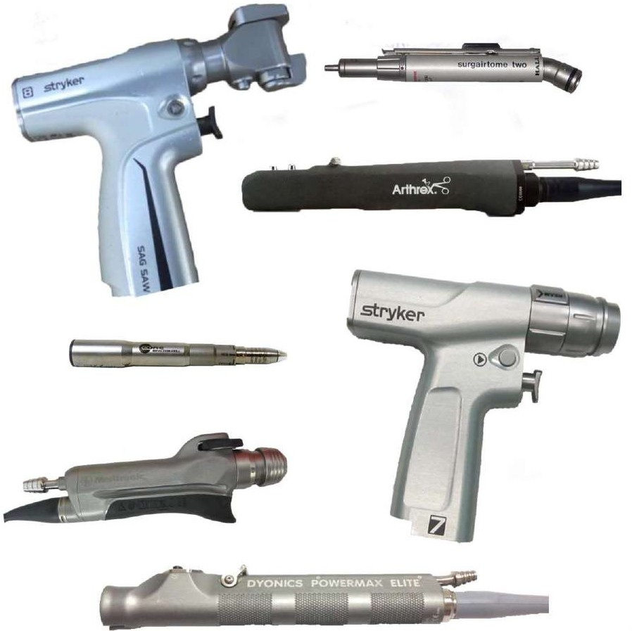
Repair Capabilities 2024

Slide 16
ConMed® Linvatec Hall® Equipment
Shavers
2 Button Apex Shaver Basic Apex Shaver
Full Function Apex Shaver
Small Joint Apex Shaver Ergo™ Shaver
Linvatec Advantage® No Button Shaver
Linvatec Advantage® 2 Button Shaver Linvatec Turbo No Button Shaver Linvatec Turbo Button Shaver
C9824 C9820 C9828 C9840 D4240 D9820 D9824 D9920 D9924
$1045.00
$1045.00
$1045.00
$875.00
$1045.00
$1045.00
$1045.00
$1045.00
$1045.00
Average Repair Pricing
Phone: 1-800-829-7694
Fax: 574-453-3797
www.nuell.com
Shipping:
PowerPro® Electric II |  |  | Nuell, Inc. Repair Department
Single Trigger Modular Handpiece | PRO6100 | $985.00 | 312 East Van Buren St
Oscillating Saw | PRO6125 | $985.00 | Leesburg, IN 46538
Reciprocating Saw | PRO6135 | $985.00
PowerPro® Pneumatic
Single Trigger | PRO6150 | $545.00
Oscillating Saw | PRO6175 | $545.00
Reciprocating Saw | PRO6185 | $545.00
MPower®
Single Trigger Modular Handpiece | PRO6200 | $985.00
2-Trigger Modular Handpiece | PRO6202 | $985.00
Oscillating Saw | PRO6300 | $985.00
Reciprocating Saw | PRO6400 | $985.00
MPower® 2
Single Trigger Modular Handpiece | PRO6200M | $985.00
2-Trigger Full Function Modular Handpiece | PRO6202M | $985.00
Dual Trigger Standard Modular Handpiece | PRO6212M | $985.00
Dedicated Oscillating Saw | PRO6350M | $985.00
Dedicated Reciprocating Saw | PRO6400M | $985.00
Hall® 50
Single Trigger Modular Handpiece | PRO7100B | $1095.00
Dual Trigger Modular Handpiece | PRO7200B | $1095.00
Oscillating Saw | PRO7300B | $1095.00
Reciprocating Saw | PRO7400B | $1095.00
Sternum Saw | PRO7450B | $1095.00
Please call us if you have any equipment not listed here.
1-800-829-7694

Slide 17
Average Repair Pricing
Hall® Micro 100 Series
Drill | 5053-09 | $435.00
Reciprocating Saw | 5053-10 | $435.00
Sagittal Saw | 5053-11 | $435.00
Oscillating Saw | 5053-12 | $435.00
Wiredriver 100 | 5053-13 | $545.00
Surgairtome II | 5058-01 | $385.00
Hall® Micro 160 Series
Drill | 5053-01 | $435.00
Oscillating Saw | 5053-07 | $435.00
Reciprocating Saw | 5053-02 | $435.00
Sagittal Saw | 5053-03 | $435.00
Wiredriver | 5053-04 | $545.00
Hall® Series III
Drill Reamer | 5044-01 | $545.00
Oscillator | 5044-02 | $545.00
Trauma Drill | 5044-10 | $545.00
Reciprocator | 5044-03 | $545.00
ConMed Linvatec® Series IV
Drill Reamer | 5067-01 | $545.00
Oscillator | 5067-02 | $545.00
Reciprocator | 5067-03 | $545.00
Trauma Drill | 5067-04 | $545.00
Hall® Micro Choice (mechanical only
Medium Speed Drill | 5020-021 | $545.00
Sagittal Saw | 5020-022 | $545.00
Reciprocating Saw | 5020-023 | $545.00
Oscillating Saw | 5020-024 | $545.00
High Speed Drill | 5020-025 | $545.00
Low Speed Drill | 5020-026 | $545.00
Wiredriver & Fixation Drill | 5020-027 | $875.00
Phone: 1-800-829-7694
Fax: 574-453-3797
www.nuell.com
Shipping:
Nuell, Inc. Repair Department 312 East Van Buren St
Leesburg, IN 46538
Linvatec® Micro Power (mechanical only)
Removable Levers
Medium Speed Drill | 6020-021 | $545.00
Sagittal Saw | 6020-022 | $545.00
Reciprocating Saw | 6020-023 | $545.00
Oscillating Saw | 6020-024 | $545.00
Oral/Max High Speed Drill | 6020-025 | $545.00
Orthopedic High Speed Drill | 6020-026 | $545.00
Permanently Attached Levers Medium Speed Drill | 6021-021 | $545.00
Sagittal Saw | 6021-022 | $545.00
Reciprocating Saw | 6021-023 | $545.00
Oscillating Saw | 6021-024 | $545.00
Oral/Max High Speed Drill | 6021-025 | $545.00
Orthopedic High Speed Drill | 6021-026 | $545.00
Please call us if you have any equipment not listed here.
1-800-829-7694

Slide 18
Average Repair Pricing
Miscellaneous/Specialty Cebatome | 5052-41 | $545.00
Sternum Saw | 5059-05 | $545.00
Zimmer Electric Dermatome | 8821-01 | $1183.00
Zimmer Air Dermatome | 8801-01 | $655.00
Hose | 10 Feet | $190.00
Bur Guards |  | $60.00
Integra® Padgett® Dermatomes
Phone: 1-800-829-7694
Fax: 574-453-3797
www.nuell.com
Nitrogen Air Dermatome Electric Dermatome Electric Dermatome
Electric Slimline Dermatome Electric Slimline Dermatome
A B PI S S6
$765.00
$875.00
$875.00
$1095.00
$1095.00
Shipping:
Nuell, Inc. Repair Department 312 East Van Buren St Leesburg, IN 46538
Stryker® Equipment
Stryker® Command and Command II
50K Drill
Hand switch | 2296-210 | $655.00
Footswitch | 2296-10 | $655.00
20° 50K Drill Hand switch | 2296-212 | $655.00
Footswitch | 2296-12 | $655.00
20° Neuro Drill
Hand switch | 2296-216 | $715.00
Footswitch | 2296-16 | $715.00
Oscillating Saw
Hand switch | 2296-231 | $715.00
Footswitch | 2296-31 | $715.00
Reciprocating Saw
Hand switch | 2296-237 | $715.00
Footswitch | 2296-37 | $715.00
Sagittal Saw Hand switch | 2296-234 | $715.00
Footswitch | 2296-34 | $715.00
Micro Driver | 2296-88 | $825.00
Command II Impaction Drill | 2296-300 | $814.00
Command II Cord | 296-4 | $291.50
Stryker® RemB
Micro Drill | 6400-15 | $644.00
Oscillating | 6400-31 | $644.00
Sagittal Saw | 6400-34 | $644.00
Reciprocator | 6400-37 | $644.00
Wire Driver | 6400-62 | $853.00
Universal Drill | 6400-99 | $853.00
Please call us if you have any equipment not listed here.
1-800-829-7694

Slide 19
Average Repair Pricing
Stryker® TPS™
Universal Drill | 5100-010 | $644.00
U2 Drill | 5100-100 | $644.00
Micro Drill | 5100-15 | $644.00
Oscillating | 5100-31 | $644.00
Sagittal Saw | 5100-34 | $644.00
Reciprocator | 5100-37 | $644.00
Cord | 5100-4 | $292.00
Micro Driver | 5100-88 | $853.00
Universal Driver | 5100-99 | $853.00
Stryker® Core™
Micro Drill | 5400-15 | $644.00
Oscillating | 5400-31 | $644.00
Sagittal Saw | 5400-34 | $644.00
Reciprocator | 5400-37 | $644.00
Universal Driver | 5400-99 | $853.00
Core Maestro Drill | 5400-200 | $1045.00
Core Impaction Drill | 5400-300 | $655.00
Core UHT Drill | 5400-110-000 | $1018.00
Core Saber Drill | 5400-120-000 | $1018.00
Core Sumex Drill | 5400-130-000 | $1018.00
System 4
Cordless Driver | 4100 | $1045.00
Rotary Drill | 4103 | $1045.00
Reciprocator | 4106 | $1045.00
Recip/Sternum | 4107 | $1045.00
Sagittal Saw | 4108 | $1045.00
System 5 Cordless Driver | 4200 | $1045.00
Single Trigger Rotary | 4203 | $1045.00
Dual Trigger Rotary | 4205 | $1045.00
Reciprocator | 4206 | $1045.00
Recip/Sternum Saw | 4207 | $1045.00
Sagittal Saw | 4208 | $1045.00
System 6 Single Trigger Rotary | 6203 | $1535.00
Dual Trigger Rotary | 6205 | $1535.00
Reciprocator | 6206 | $1535.00
Sternum Saw | 6207 | $1535.00
Sagittal Saw | 6208 | $1535.00
Precision Saw | 6209 | $1535.00
Cordless Driver 3 | 4300 | $1535.00
Sabo Sagittal Saw | 4300-034 | $1535.00
Phone: 1-800-829-7694
Fax: 574-453-3797
www.nuell.com
Shipping:
Nuell, Inc. Repair Department 312 East Van Buren St
Leesburg, IN 46538
Please call us if you have any equipment not listed here.
1-800-829-7694

Slide 20
Average Repair Pricing
System 7
Single Trigger Rotary |  | 7203 | $1535.00
Dual Trigger Rotary |  | 7205 | $1535.00
Reciprocator |  | 7206 | $1535.00
Sternum Saw |  | 7207 | $1535.00
Sagittal Saw |  | 7208 | $1535.00
Precision Saw |  | 7209 | $1535.00
Cordless Driver 4 |  | 4405 | $1535.00
Sabo 2 Sagittal Saw |  | 4408 | $1535.00
System 8
Dual Trigger Rotary |  | 8205 | $1535.00
Reciprocator |  | 8206 | $1535.00
Sternum Saw |  | 8207 | $1535.00
Sagittal Saw |  | 8208 | $1535.00
Cordless Driver |  | 4505 | $1535.00
Sabo Saw |  | 4508 | $1535.00
Shavers
12K Shaver |  | 272-704-500 | $1045.00
Foot Controlled |  | 275-701-500 | $1045.00
Hand Controlled |  | 275-704-500 | $1045.00
Formula Shaver Foot Controlled |  | 375-701-500 | $1045.00
Hand Controlled |  | 375-704-500 | $1045.00
TPS Small Joint Shaver |  | 275-601-500 | $875.00
6K Micro Shaver |  | 275-601-800 | $875.00
Formula 180° Shaver |  | 375-708-500 | $1045.00
ARTHREX® SHAVERS
Arthrex APS II Hand Controlled Shaver |  | AR-8330H | $1634.00
Arthrex APS II Foot Controlled Shaver |  | AR-8330F | $1634.00
Arthrex Synergy Shaver |  | AR-8332H | $1634.00
Arthrex Synergy Resection Shaver |  | AR-8330SJ | $1634.00
Arthrex APS II Hand Controlled, |  | AR-8330RH | $1634.00
Back Hand Shaver
Pneumatic
Roto Osteotome 10° | 277-10 |  | $495.00
Roto Osteotome 20° | 277-12 |  | $578.00
Oscillating Saw | 277-30/277-31 |  | $605.00
Sagittal Saw | 277-34/277-134 |  | $605.00
Reciprocating Saw DYONICS® EQUIPMENT | 277-37 |  | $605.00
Power Shaver
Hand Controlled | 7205354 |  | $1045.00
Foot Controlled | 7205355 |  | $1045.00
Ultralite Shaver | 7205971 |  | $1045.00
Mini EP-1 Shaver | 7205357 |  | $875.00
Power Max Shaver
Hand Controlled | 7210542 |  | $1045.00
Foot Controlled | 7210586 |  | $1045.00
Phone: 1-800-829-7694
Fax: 574-453-3797
www.nuell.com
Shipping:
Nuell, Inc. Repair Department 312 East Van Buren St
Leesburg, IN 46538
Please call us if you have any equipment not listed here.
1-800-829-7694

Slide 21
Average Repair Pricing
Smith & Nephew Trivex System Handpiece | 7210387 | $1634.00
Smith & Nephew True Clear Hysteroscopy | 7209208 | $1634.00
Power Max Elite Shaver Hand Controlled | 72200616 | $1045.00
Foot Controlled | 72200617 | $1045.00
Coviden Shaver | 7209807 | $1634.00
MIDAS REX® EQUIPMENT
Straight and Angle |  | $875.00
Midas Rex® |  | $875.00
Midas Rex® Legends |  | $798.00
Midas Rex Legend Motor/hose | PM700 | $985.00
Midas Rex MR7 Touch Motor w/hose | PM710 | $985.00
Midas Rex® Legend | EM100 | $385.00
Midas Rex Legend EHS Drill | EM100-A | $798.00
Phone: 1-800-829-7694
Fax: 574-453-3797
www.nuell.com
:
Department Buren St
46538
Midas Rex® Legend MEDTRONIC® EQUIPMENT | EM200 | _{$798.00} Shipping Nuell, Inc. Repair 312 East Van Leesburg, IN
Xomed XPS® Straight Shot® Handpiece | 18-95200 | $875.00
Xomed Straight Shot® Magnum | 18-96200 | $875.00
Xomed Straight Shot® Magnum II | 18-97200 | $875.00
Xomed Straight Shot® M4 Microdebrider | 18-98200T | $1535.00
Xomed Straight Shot® M5 Microdebrider | 18-99200 | $1535.00
Xomed Skeeter® UltraLite OtoTool | 30-55601 | $798.00
Xomed Visao® High Speed Otologic Drill | 33-34800 | $798.00
ANSPACH® EQUIPMENT
Black Max |  | $798.00
Micro Max |  | $798.00
Emax 2 Plus Motor | Emax2 | $798.00
Gi High Speed Electric System | eG1e | $798.00
DePuy® EQUIPMENT
Bone Mills |  | $607.00-$1456.00
SYNTHES® EQUIPMENT
Compact Air Driver II | 511.701 | $605.00
Compact Air Drive | 511.70 | $605.00
Synthes® Air Drill | 511.10 | $605.00
Oscillating Bone Saw | 518.01 | $605.00
Compress Air Motor | 512.10 | $605.00
Synthes Small Battery Drive | 532.010 | $1205.00
Synthes Small Battery Drive II | 532.110 | $1205.00
Synthes Battery Oscillator | 530.610 | $1205.00
Synthes Battery Oscillator II | 530.710 | $1205.00
Synthes Battery Reamer/Drill | 530.705 | $1205.00
Synthes Colibri II Handpiece | 532.101 | $1205.00
Please call us if you have any equipment not listed here.
1-800-829-7694

Slide 22
Average Repair Pricing
3M® EQUIPMENT
Maxi Driver Series Maxi Driver I | L100 | $545.00
Maxi Driver II | L100 | $545.00
Maxi Driver III | G100 | $715.00
Mini Driver Series Mini Driver I | K100 | $545.00
Mini Driver II | K200 | $545.00
Micro Driver | U100 | $545.00
Minos Low Speed | A300 | $688.00
High Speed | A200 | $688.00
Miscellaneous Air Driver | D200 | $605.00
Crainotome | C100 | $605.00
Centurion Ozil Phaco Handpiece | 8065751761 | $1695.00
Alcon Infiniti Ozil Handpiece | 8065750469 | $1695.00
Bausch & Lomb Phaco Handpiece | BL3170 | $1695.00
Ethicon Endo Surgery Harmonic Scalpel |  | $650.00
Harmonic Blue Handpiece |  | $650.00
Cryo Probes Frigitronics |  | $1,395.00
Keeler |  | $1,595.00
Cardiac |  | $1,895.00
Phone: 1-800-829-7694
Fax: 574-453-3797
www.nuell.com
Shipping:
Nuell, Inc. Repair Department 312 East Van Buren St
Leesburg, IN 46538
Nuell, Inc.™ also repairs various powered equipment from the following manufactures:
MicroAire®, Sarns®, DePuy® and Codman®.

Slide 23
Facts about Nuell, Inc. you should know:
Nuell, Inc. has been repairing powered surgical instruments since 1968.
Nuell, Inc. has one of the best warranties in the industry.
Nuell, Inc. offers loaners free of charge at a first come first serve basis.
Nuell, Inc. offers free quoting, when requested.
Nuell, Inc. also offers quality refurbished equipment
MISSION STATEMENT
OUR CORPORATE GOAL AT NUELL, INC. IS TO PROVIDE OUR CUSTOMERS WITH SUPERIOR REPAIRS AT A COMPETITIVE PRICE. WE WILL STRIVE TO PROVIDE OUR CUSTOMERS WITH AN EXCELLENT TURNAROUND TIME WHILE KEEPING PATIENT SAFETY UP-MOST IN OUR MINDS.

Slide 24
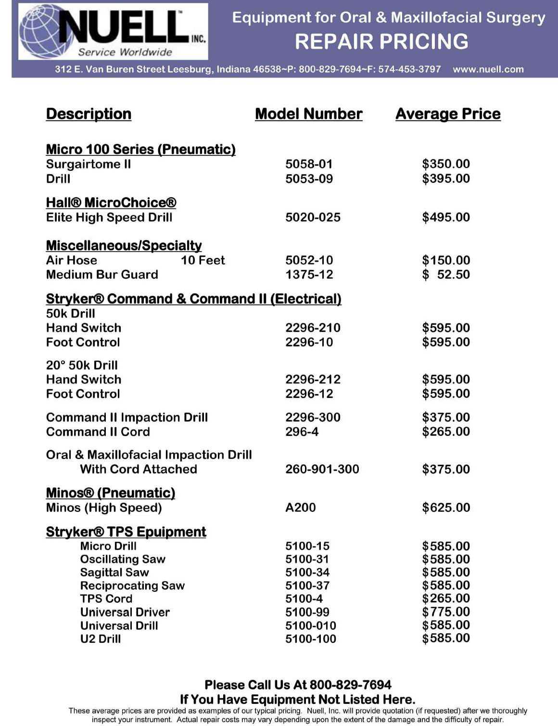

Slide 25
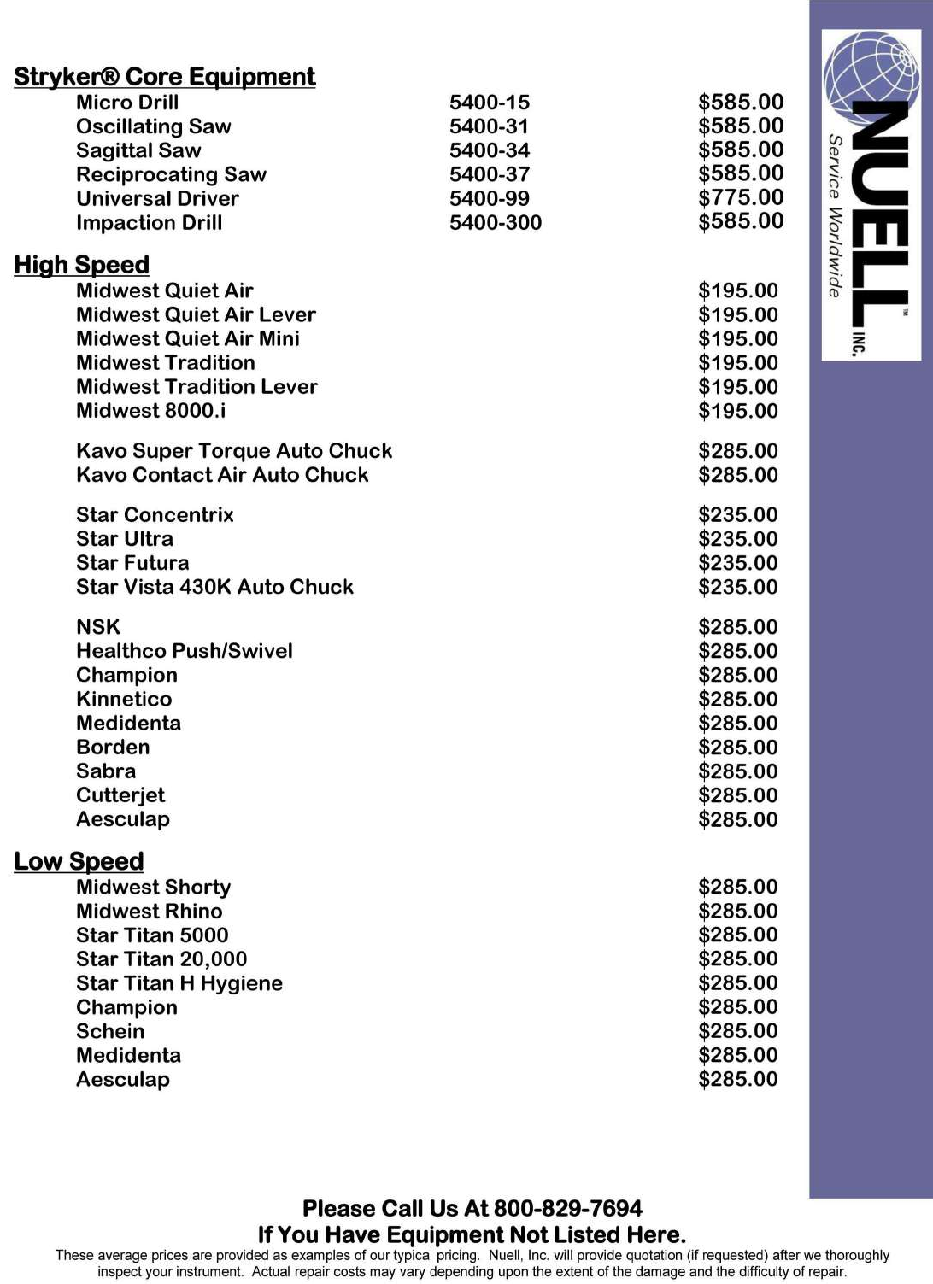

Slide 27
312 E Van Buren St l Leesburg, IN 46538 Tel: 800.829.7694 l Fax: 574.453.3797
...powerful medicine for your instruments.
Call: 800-829-7694
www.nuell.com

Slide 28
312 E Van Buren St l Leesburg, IN 46538 Tel: 800.829.7694 l Fax: 574.453.3797
...powerful medicine for your instruments.
As one of the largest and oldest independent service organizations in the country, we continue to offer our repair services on surgical hand pieces and accessories to the oral surgery field, hospitals, and surgery centers.
Extensive capabilities offered for pneumatic and electrical hand pieces and accessories; including but not limited to the following OEM’s:
ConMed/Linvatec/Hall/3M
Micro Aire
W&H
Synthes
Stryker
Brasseler
Zimmer
Features and benefits that set us apart from our competition:
Nearly 50 years of Experience
Liability Insurance
FDA Registered
In house Machine Shop
Estimates available within 24 hours
Competitive Turnaround Time
6 month Warranty on all parts and labor performed
Loaners available at No Charge on a first-come, first-served basis
In house Research and Development
Ability to Repair equipment deemed “obsolete” or “non-repairable” by others
New Equipment Sales and repairs for air hoses, bur guards, adaptors, and much more
Preventative Maintenance and Educational Programs available
Here at Nuell, Inc. our corporate goal is to provide our customers with superior repairs at a competitive price. We will strive to provide our customers with an excellent turnaround time while keeping patient safety utmost in our minds.
Call: 800-829-7694
www.nuell.com

Slide 29
312 E Van Buren St l Leesburg, IN 46538 Tel: 800.829.7694 l Fax: 574.453.3797
...powerful medicine for your instruments.
As one of the largest and oldest independent service organizations in the country, we continue to offer our repair services on surgical hand pieces and accessories to the oral surgery field, hospitals, and surgery centers.
Be sure to take advantage of the many great services offered; such as arthroscopic shaver repairs.
Turnaround in 3 to 5 business days Trained Technicians in Factory Setting High Quality
Features and benefits that set us apart from our competition:
Nearly 50 years of Experience
Liability Insurance
FDA Registered
In house Machine Shop
Estimates available within 24 hours
Competitive Turnaround Time
6 month Warranty on all parts and labor performed
Loaners available at No Charge on a first-come, first-served basis
In house Research and Development
Ability to Repair equipment deemed “obsolete” or “non-repairable” by others
Preventative Maintenance and Educational Programs available
Here at Nuell, Inc. our corporate goal is to provide our customers with superior repairs at a competitive price. We will strive to provide our customers with an excellent turnaround time while keeping patient safety utmost in our minds.
Call: 800-829-7694
www.nuell.com

Slide 30
312 E Van Buren St l Leesburg, IN 46538 Tel: 800.829.7694 l Fax: 574.453.3797
...powerful medicine for your instruments.
As one of the largest and oldest independent service organizations in the country, we continue to meet the needs and demands of the oral surgery field, hospitals, and surgery centers.
Be sure to take advantage of the many great services offered; such as surgical instrument repairs. From general sharpening to your most delicate repairs
Turnaround in 3 to 5 business days Trained Technicians in Factory Setting High Quality
Other features and benefits that set us apart from our competition:
Nearly 50 years of Experience
Liability Insurance
FDA Registered
In house Machine Shop
Estimates available within 24 hours
Competitive Turnaround Time
In house Research and Development
Ability to Repair equipment deemed “obsolete” or “non-repairable” by others
Preventative Maintenance and Educational Programs available
Here at Nuell, Inc. our corporate goal is to provide our customers with superior repairs at a competitive price. We will strive to provide our customers with an excellent turnaround time while keeping patient safety utmost in our minds.
Contact our Customer Service department with any other questions you have regarding these services.
Call: 800-829-7694
www.nuell.com

Slide 31
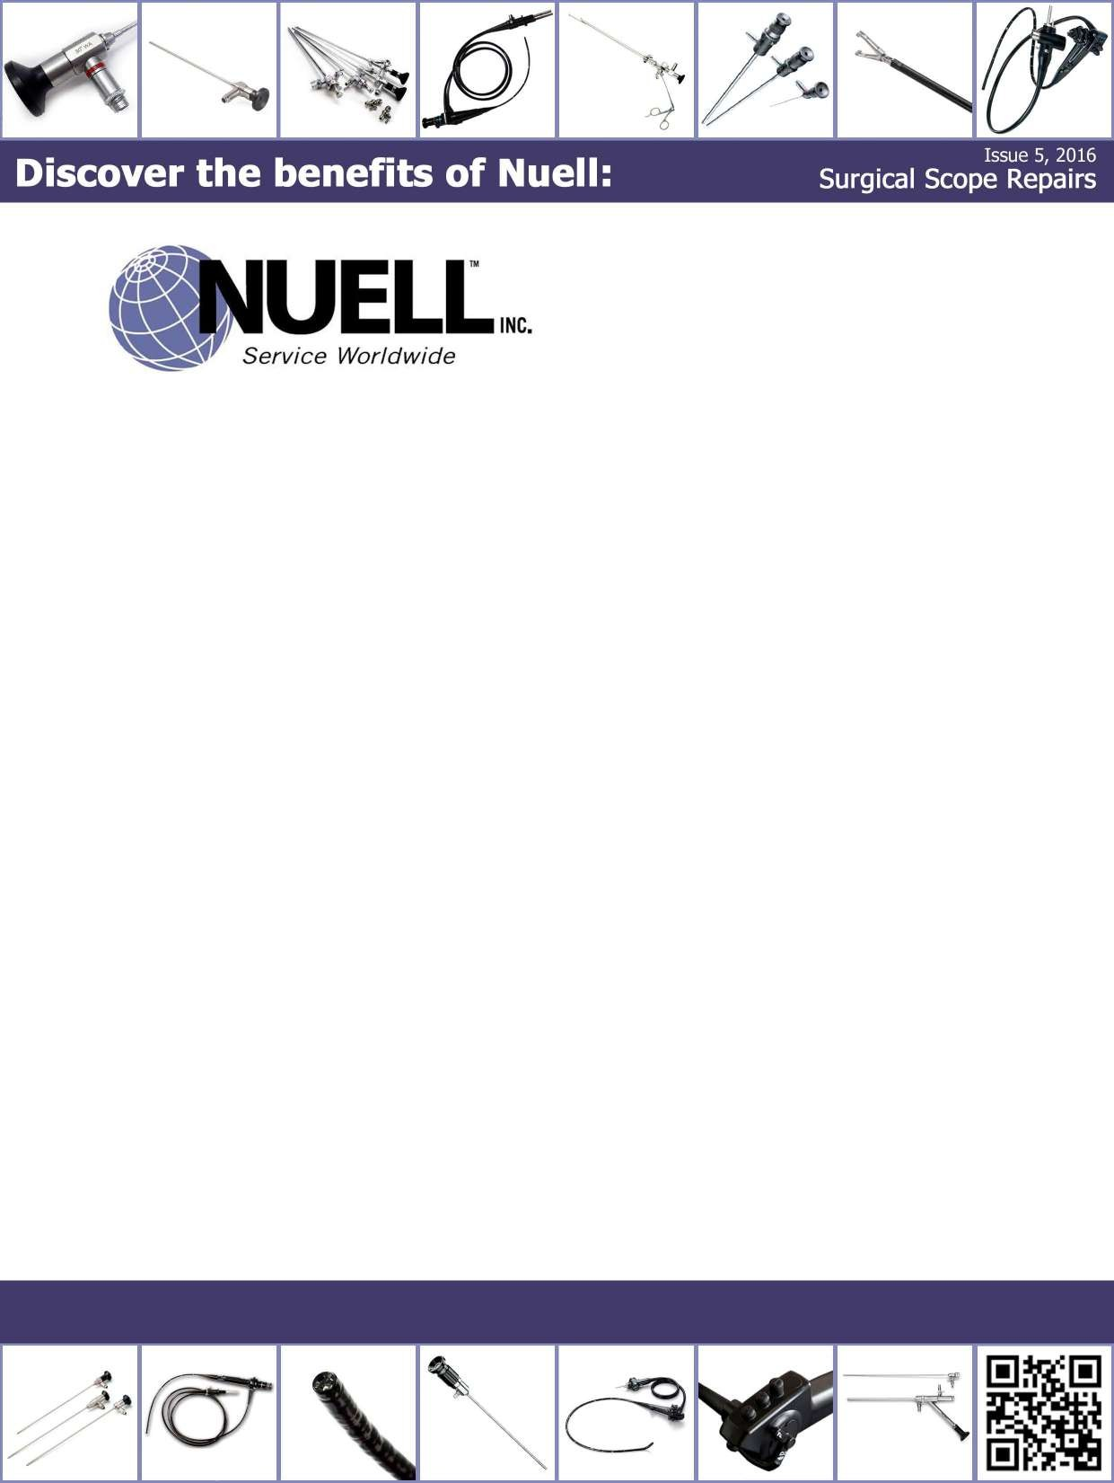
312 E Van Buren St l Leesburg, IN 46538 Tel: 800.829.7694 l Fax: 574.453.3797
...powerful medicine for your instruments.
As one of the largest and oldest independent service organizations in the country, we continue to meet the needs and demands of the oral surgery field, hospitals, and surgery centers.
Be sure to take advantage of the many great services offered; such as surgical scope repairs.
Turnaround in 5 to 7 business days Trained Technicians in Factory Setting High Quality
Other features and benefits that set us apart from our competition:
Nearly 50 years of Experience
Liability Insurance
FDA Registered
In house Machine Shop
Estimates available within 24 hours
Competitive Turnaround Time
6 month Warranty on all parts and labor performed
Loaners available at No Charge on a first-come, first-served basis
In house Research and Development
Ability to Repair equipment deemed “obsolete” or “non-repairable” by others
Preventative Maintenance and Educational Programs available
Here at Nuell, Inc. our corporate goal is to provide our customers with superior repairs at a competitive price. We will strive to provide our customers with an excellent turnaround time while keeping patient safety utmost in our minds.
Contact our Customer Service department with any other questions you have regarding these services.
Call: 800-829-7694
www.nuell.com

Slide 32
312 E Van Buren St l Leesburg, IN 46538 Tel: 800.829.7694 l Fax: 574.453.3797
...powerful medicine for your instruments.
As one of the largest and oldest independent service organizations in the country, we continue to meet the needs and demands of the oral surgery field, hospitals, and surgery centers.
Be sure to take advantage of the many great services offered; such as repairs of cameras, cryoprobes, fiberoptic cables, phaco hand pieces, and much more
Turnaround in 5 to 7 business days Trained Technicians in Factory Setting High Quality
Other features and benefits that set us apart from our competition:
Nearly 50 years of Experience
Liability Insurance
FDA Registered
In house Machine Shop
Estimates available within 24 hours
Competitive Turnaround Time
6 month Warranty on all parts and labor performed
In house Research and Development
Ability to Repair equipment deemed “obsolete” or “non-repairable” by others
Preventative Maintenance and Educational Programs available
Here at Nuell, Inc. our corporate goal is to provide our customers with superior repairs at a competitive price. We will strive to provide our customers with an excellent turnaround time while keeping patient safety utmost in our minds.
Contact our Customer Service department with any other questions you have regarding these services.
Call: 800-829-7694
www.nuell.com

